Slide 1
Medical Insurance Cost Prediction
AVANTHI U C
End-to-End Regression Project
Using Machine Learning & Streamlit

Slide 2
Problem Statement
Build an end-to-end regression project to predict individual medical insurance costs based on factors such as age, gender, BMI, smoking status, and number of dependents. Utilize the provided dataset to clean and engineer features, train multiple regression models, and deploy the best model in a Streamlit application. The app should allow users to input personal health and demographic details to estimate their medical insurance costs.

Slide 3
Business Use Cases
Assisting insurance companies in determining personalized insurance premiums.
Helping individuals plan and compare medical insurance policies based on their profile.
Supporting healthcare consultants in estimating out-of-pocket medical costs.
Providing cost transparency and increasing financial awareness among policyholders.

Slide 4
Dataset Overview
Features Included:
age: Age of the primary beneficiary
sex: Gender (male/female)
bmi: Body mass index
children: Number of dependents covered by health insurance
smoker: Whether the individual is a smoker
region: Residential area (northeast, northwest, southeast, southwest)
charges: Individual medical costs billed by health insurance (target variable)

Slide 5
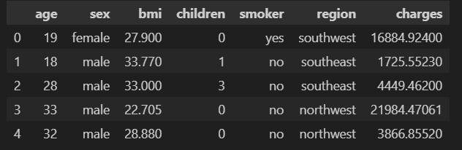
DATASET

Slide 6
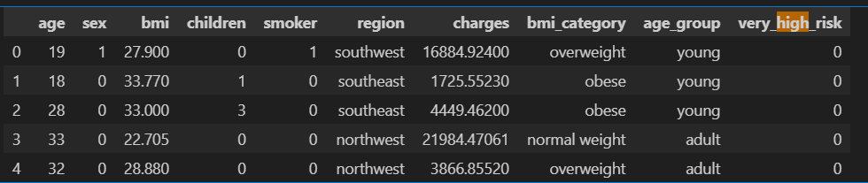
Data Preprocessing
• Checked missing & duplicate values
• Encoded categorical variables
• Scaled numerical features (Age, BMI, Children)
• Feature engineering (BMI categories, risk logic)

Slide 7
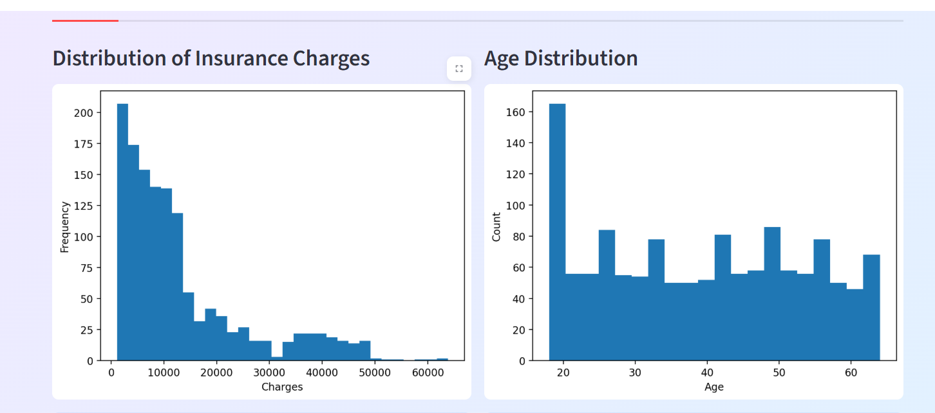
Exploratory Data Analysis
• Charges distribution (Right-skewed)
• Smoking significantly increases charges
• Age positively correlates with charges
• Obese smokers have highest costs

Slide 8
Model Building
Trained Multiple Regression Models:
• Linear Regression
• Random Forest
• XGBoost
Ridge Regression
Lasso Regression
Gradient Boost Regressor
Compared using RMSE, MAE, and R²

Slide 9
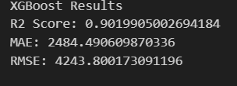
Model Evaluation
Selected best-performing model – XG BOOST
Tracked experiments using MLflow
Registered best model in model registry

Slide 10
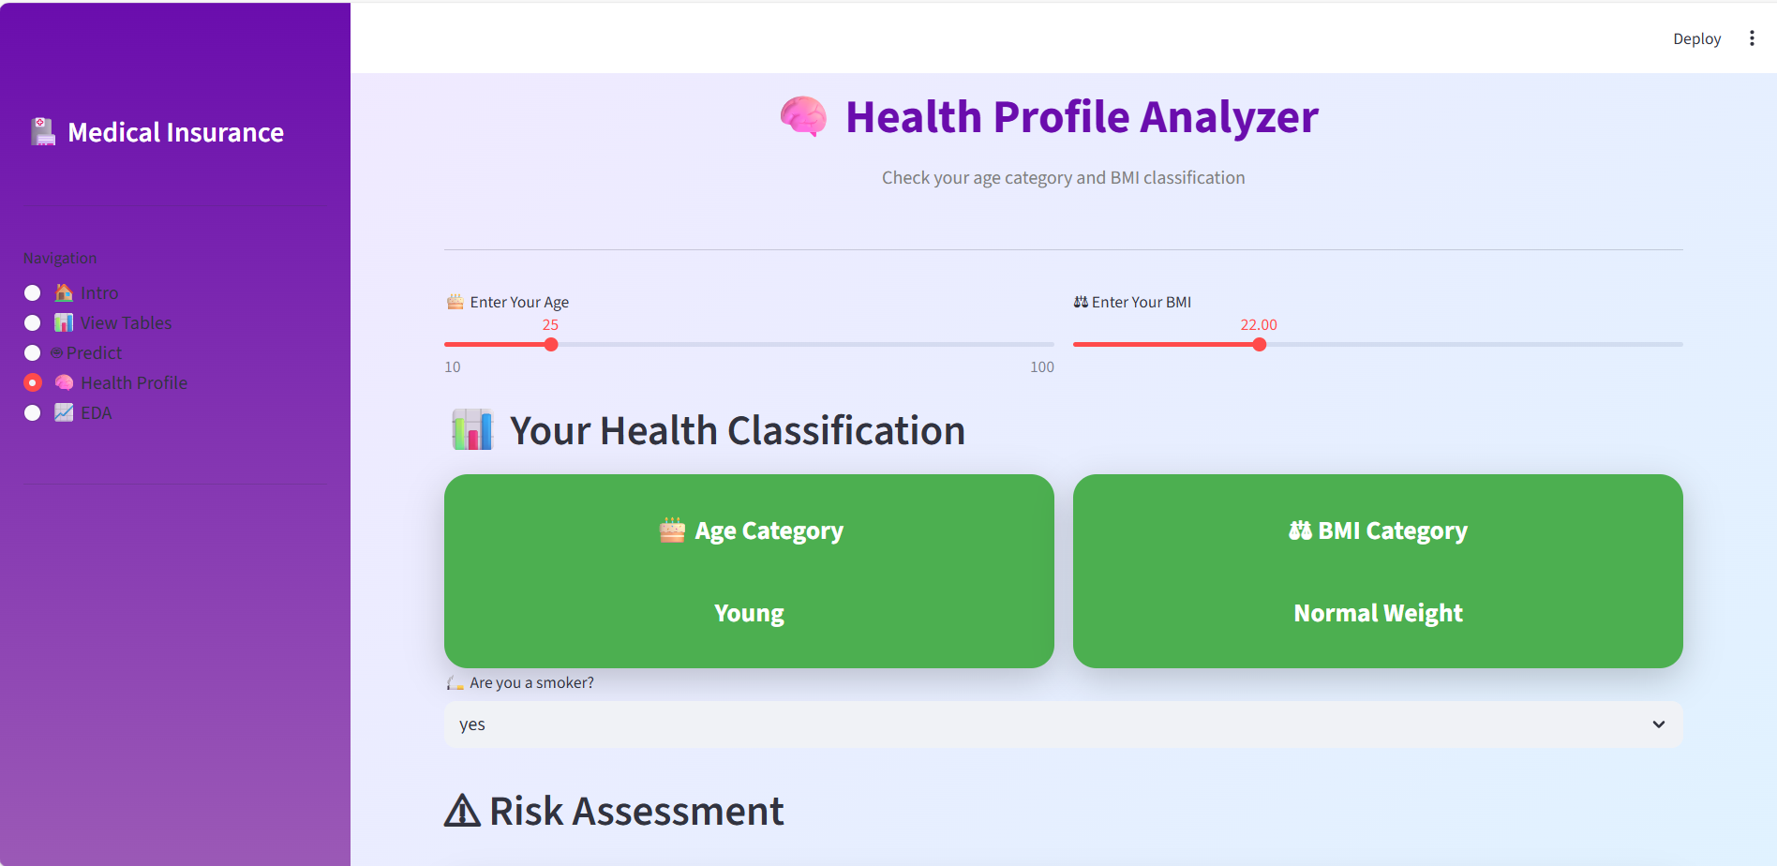
Streamlit Application
• Interactive EDA dashboard
• Risk classification system
• Insurance cost prediction
• Health profile analyzer

Slide 11
Key Insights
• Smoking is the strongest predictor of cost
• Age increases medical expenses
• Obese smokers face highest premiums
• BMI and region moderately impact charges

